Slide 1

Software Engineering
Emerging Topics in Software Engineering
Prof. Mohamad Kassab m.kassab@nyu.edu

Slide 2

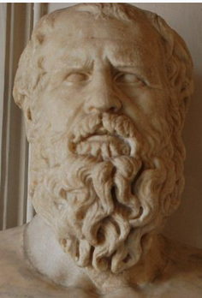

Shaping Factors of the Future Landscape of Requirements Engineering
Heraclitus: Constant change is fundamental.
Let’s examine the factors that are influencing and reshaping the Software Engineering discipline.

Slide 3

1- Technological disruptions
There is no question that technological disruption (e.g., AI, IoT, Blockchain) will affect the way that businesses, consumers, or industries function.
These same technologies will also influence the software engineering practices.
We will discuss the relationship between these technologies and the software engineering shortly.

Slide 4

2-Distributed software engineering
Moreover, as systems become more and more distributed and divided into a set of components, so do the requirements as well.
Globalization, and outsourcing drive the implementation of market-specific features.
Stakeholders can be geographically located in multiple certain countries and components sourced from even other countries.

Slide 5

3- COTS
Systems are no longer always built from scratch. Companies are transitioning to offering products as services instead of standalone offerings.
The use of Commercial off-the-shelf (COTS) software and the move to microservices architectures and cross-organizational systems will also influence the traditional requirements engineering practices.
For example, requirements will keep on being layered on top of one another due to the separation of program features into separate services, these will need to have their own set of requirements, as well as proper maintenance.

Slide 6

4- Open source movement
The ongoing open-source movement will keep on influencing software engineering practices as well.
As engineers keep on using modules from a myriad of other developers, more focus must be paid to ensuring licenses compliance, and the potential of constant updates breaking the system and the packages’ average lifetime.

Slide 7
4- Open SOURCE MOVEMENT
Open-source software (OSS) is computer software that is released under a license in which the copyright holder grants users the rights to use, study, change, and distribute the software and its source code to anyone and for any purpose.
Open-source software may be developed in a collaborative, public manner.
Open-source software is a prominent example of open collaboration, meaning any capable user is able to participate online in development, making the number of possible contributors indefinite.
The ability to examine the code facilitates public trust in the software

Slide 8
Software ENGINEERING IN SMALL BUSINESSES
These factors impacting Software Engineering comes alongside increasing in startup formation.
Startups typically small businesses.
Exploring Software Engineering practices in small business contexts

Slide 9
Requirements Engineering for Small Businesses
Small businesses are defined as enterprises that employ fewer than 50 persons and whose annual turnover or annual balance sheet total does not exceed EUR 10 million, according to the European Commission (2005).
Hence, most startups may also be considered as small businesses. In the United States, 88% of employer firms are considered to be small businesses (JPMorgan, 2018).
These businesses accounted for over half of net job creation in the U.S. in 2014.
According to the U.S. Small Business Administration, the overwhelming majority of software development firms are also considered to be small businesses, and this will most likely continue to be the case for the next decade.

Slide 10
LACK OF REQUIREMENTS ENGINEERING IN SMALL BUSINESSES
Due to the small staff sizes, often the requirements engineer is also the developer, architect, and/or the QA.
The learning curve in implementing the industry’s best practices for RE is steep and requires hiring talents with a solid educational and practical background which can be a financial burden on a small business.
Financial constraints can also hamper the use of RE processes and tools. Typically, a small organization’s attention to RE may come only after early successes that haven’t relied heavily on it.

Slide 11
Re in small businesses
In Kassab (2021) (Supplemental Reading), observations from the four RE surveys are reported on how requirements engineering are conducted in small businesses:
A wide diversity in the employed requirements engineering practices for small businesses was reported in the 2020 Survey.
We can rationalize that this diversity is the result of evolutionary adaptation, as these businesses have to adapt to their particular ecological niche. The context of these businesses is the essence of their adopted practices.

Slide 12

Re in small businesses
Despite the diversity, we note that when requirements engineering practices are employed, there is a tendency to adopt the easy, flexible, and inexpensive techniques (e.g., the majority opted for open-source RE management tools).

Slide 13
Re in small businesses
The adoption of inexpensive requirements engineering techniques doesn’t necessarily hinder the level of satisfaction of employing them in small businesses.

Slide 14

Re in small businesses
The findings indicate a strong cultural cohesion among small businesses, with consensus on the adequacy of team size and the software development team's abilities, potentially fostering efficient communication and a shared understanding of project requirements within the small team.

Slide 15

Disruptive Technologies
Let’s now look at some technologies like Blockchain, Internet of Things, or AI and examine how the software engineering discipline will be influenced with these technologies.

Slide 16
Software Engineering and Blockchain

Slide 17
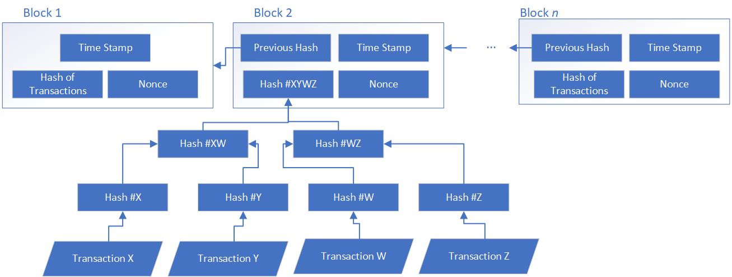
Blockchain - Background
Decentralization
Immutability
Consensus
Provenance
Finality
Notes:
The technology of blockchain attracted considerable attention due to the possibility of recording all financial transactions in a secure and verifiable decentralized (peer-to-peer) fashion, without the rule from a third party to process transactions.
which are then combined into blocks where each block contains a timestamp and is linked to its precedent block.
Once recorded, data cannot be altered, and the transactions history is combined into a chain structure without the possibility of additional branches of alternative transactions emerging or wedging into the middle of a chain.
Provenance refers to awareness that participants of the network have about where the asset was originated from and its ownership history,
while finality refers to the status of a transaction as complete.

Slide 18

Blockchain Structure
Decentralized structure with each node maintaining a copy of the blockchain.
Consensus mechanisms for validating new blocks.
Immutability through cryptographic hashes and timestamps.
Finality and Provenance ensuring a single, shared ledger.

Slide 19
Blockchain Background
The technology of blockchain attracted considerable attention due to the possibility of recording all financial transactions in a secure and verifiable decentralized (peer-to-peer) fashion, without the rule from a third party to process transactions.
which are then combined into blocks where each block contains a timestamp and is linked to its precedent block.
Once recorded, data cannot be altered, and the transactions history is combined into a chain structure without the possibility of additional branches of alternative transactions emerging or wedging into the middle of a chain.
Provenance refers to awareness that participants of the network have about where the asset was originated from and its ownership history,
while finality refers to the status of a transaction as complete.

Slide 20
Blockchain Applications
Rapid recognition of transformative capabilities.
Examples of use cases beyond finance (e.g., global payments, supply chain management, healthcare, and diamond sales).
A 2018 study reported 3,000 blockchain software projects hosted on Github in March 2018. A similar search we conducted on Github in January 2021 yielded around 77,000 projects.

Slide 21
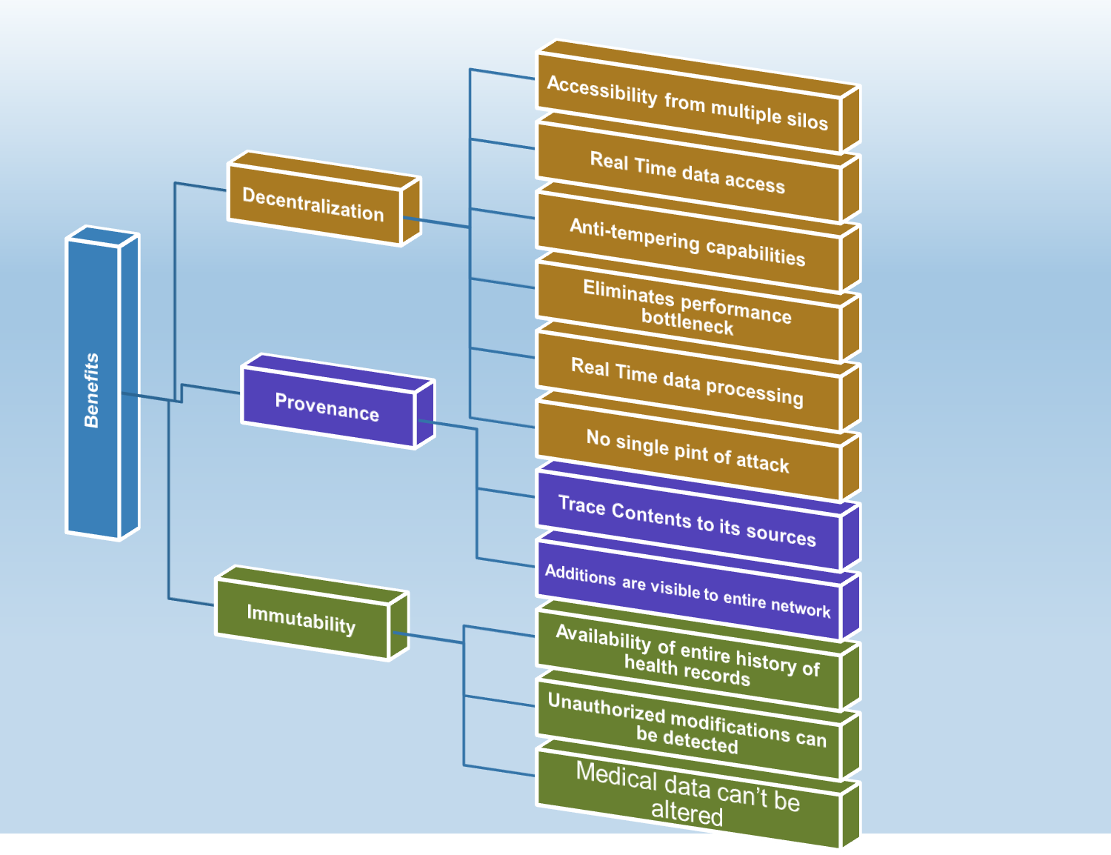
Example: Mapping of the Key Benefits of Blockchain in Healthcare Software Systems
Availability
Performance
Security
Transparency

Slide 22
SLR Overview of Results
Challenges
Decentralization
Provenance
Consensus
Finality
All blocks on every node
Conflict with Regulations
Accessing Network
Creating Large Expensive Network
Performance Bottleneck
Managing Keys
Example: Mapping of the Key Challenges of Blockchain in Healthcare
Software Systems
Performance and Scalability
Lack of Incentives and Willingness
Usability
Security
Notes:
While we could envision the use case of storing the EHRs within a blockchain, storing large medical files (e.g. X-ray and ECG), are too large for direct storage. In addition, within a blockchain deployment, the “decentralization”, “consensus” and “provenance” features imply that all blocks should be stored on every participating client node within a system.
To illustrate this scalability issue, a miners full participation in the Bitcoin network requires the miner to download the entire Bitcoin ledger, which totalled over 184 gigabytes at the end of Q3 2018. Also, the maximum transaction validation within the Bitcoin network is at seven transactions/second, which increases the possibility of a performance bottleneck.
a possible solution to this challenge is to store a large collection of medical data off the chain in a data repository. This would still be secure as the blockchain layer would enforce the access control policy. In this framework, “the patient would still have control of who has access to the personal data in the off chain because the data would not be readable without the decryption key, which is stored on the patient’s blockchain account”.
The “finality” characteristic of the blockchain can also conflict with existing legislation such as the new European GDPR13 which aims to give all citizens the ability to govern their over their data including the right for every citizen to request an institution to delete his/her personal data.

Slide 23

Economic Impact of Blockchain
World Economic Forum's estimate of 10% of global GDP stored using blockchain by 2027.
Gartner's projection of $3.1 trillion investment in blockchain technology by 2030.
Increasing demand for blockchain-related jobs and higher salaries.

Slide 24
Blockchain-Oriented Software Engineering (BOSE)
Introduction to BOSE as a new development paradigm.
Recognition of significant differences between blockchain-oriented development and traditional software development.

Slide 25
Blockchain Engineers Wanted An Empirical Analysis on Required Skills, Education, and Experience (Presentation from a Research Study)
Notes:
Hello. Thank you for inviting me to present my research. My name is Mohamad Kassab.
A bit about me - I am currently an Associate Professor in Software Engineering at Penn State University. I completed my PhD in Computer Science 2009 from Concorida University. My research was carried out within a inter-university research program involving The department of Computer Science at Concordia University in Montreal and the Department of Information Systems at University of Twente in The Netherlands.
Before joining Penn State, I was an affiliate assistant professor in the department of computer science and software engineering at Concordia University and a postdoctoral researcher in software engineering at Université du Quebec.
With about than fourteen years of industrial experiences I also worked and consulted in different roles. Recently I was acting as a Business Unit Manager for Soramitsu to develop a new blockchain technology (Iroha) and a new cryptocurrency that was just been released (Sora) . In the past few years I worked as a senior quality engineer at SAP, senior associate at Morgan Stanley, senior quality assurance specialist at NOKIA, senior software developer at Positron Safety Systems.
Throughout my employment experiences I developed a broad spectrum of skills and responsibilities in software engineering that enabled me to blend the academic research results with existing industrial practices.

Slide 26
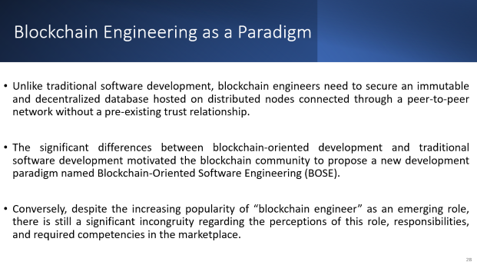
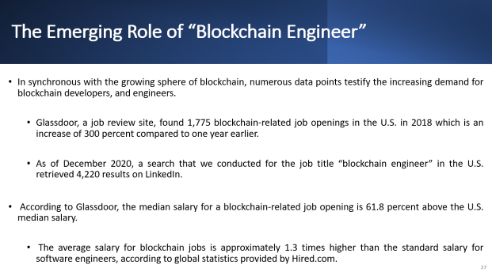
Motivation: Is there a need to Investigate the profile of “Blockchain Engineer” role?

Slide 27
The Emerging Role of “Blockchain Engineer”
In synchronous with the growing sphere of blockchain, numerous data points testify the increasing demand for blockchain developers, and engineers.
Glassdoor, a job review site, found 1,775 blockchain-related job openings in the U.S. in 2018 which is an increase of 300 percent compared to one year earlier.
As of December 2020, a search that we conducted for the job title “blockchain engineer” in the U.S. retrieved 4,220 results on LinkedIn.
According to Glassdoor, the median salary for a blockchain-related job opening is 61.8 percent above the U.S. median salary.
The average salary for blockchain jobs is approximately 1.3 times higher than the standard salary for software engineers, according to global statistics provided by Hired.com.
Notes:
The skyrocketing demand for blockchain-related jobs has also translated into a significant salary bump.
Salaries for blockchain engineers are on par with specialists focused on artificial intelligence

Slide 28
Blockchain Engineering as a Paradigm
Unlike traditional software development, blockchain engineers need to secure an immutable and decentralized database hosted on distributed nodes connected through a peer-to-peer network without a pre-existing trust relationship.
The significant differences between blockchain-oriented development and traditional software development motivated the blockchain community to propose a new development paradigm named Blockchain-Oriented Software Engineering (BOSE).
Conversely, despite the increasing popularity of “blockchain engineer” as an emerging role, there is still a significant incongruity regarding the perceptions of this role, responsibilities, and required competencies in the marketplace.
Notes:
The scarcity of tools, patterns and resources, unavoidable for a new technology, also poses a challenge for this role. Consequently, looking into the existing landscape of the job profiling for “blockchain engineer” becomes of significant importance

Slide 29
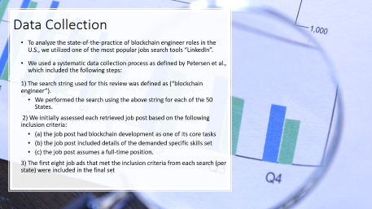
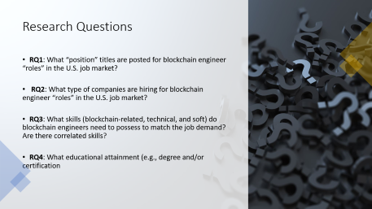
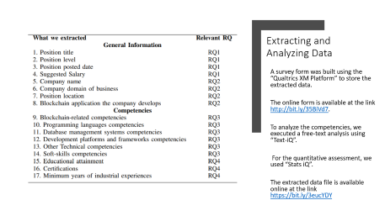
Research Methodology

Slide 30

Research Questions
RQ1: What “position” titles are posted for blockchain engineer “roles” in the U.S. job market?
RQ2: What type of companies are hiring for blockchain engineer “roles” in the U.S. job market?
RQ3: What skills (blockchain-related, technical, and soft) do blockchain engineers need to possess to match the job demand? Are there correlated skills?
RQ4: What educational attainment (e.g., degree and/or certification

Slide 31

Data Collection
To analyze the state-of-the-practice of blockchain engineer roles in the U.S., we utilized one of the most popular jobs search tools “LinkedIn”.
We used a systematic data collection process as defined by Petersen et al., which included the following steps:
1) The search string used for this review was defined as (“blockchain engineer”).
We performed the search using the above string for each of the 50 States.
2) We initially assessed each retrieved job post based on the following inclusion criteria:
(a) the job post had blockchain development as one of its core tasks
(b) the job post included details of the demanded specific skills set
(c) the job post assumes a full-time position.
3) The first eight job ads that met the inclusion criteria from each search (per state) were included in the final set
Notes:
A data collection strategy based on job posts is appropriate for the context when the qualitative data is publicly available to analyze, and when a researcher needs to establish a balance between the study execution effort on one hand and breadth and depth of the study on the other hand [14], [15].
According to Alexa Ranking by Amazon and other sources (e.g., [16]), “LinkedIn” is the most significant engine among its competitors in terms of the traffic volume and the number of jobs posted.
One of the job search engine amenities includes interpreting the search string, which results in a range of relevant jobs related to the search term. Accordingly, we obtained a wide range of position titles using the defined search string, including: Blockchain Developer, Blockchain Platform Architect, Web Developer Blockchain, Tech Lead, Java developer, etc.
We used these criteria on the text of the entire post (e.g. job title, and descriptions of the responsibilities, tasks, skill set, education, and experience).
We executed the selection process between July and August 2020, and 400 job ads from 50 states were retained in the final set for quantitative coding, analysis, and synthesis for this paper.

Slide 32
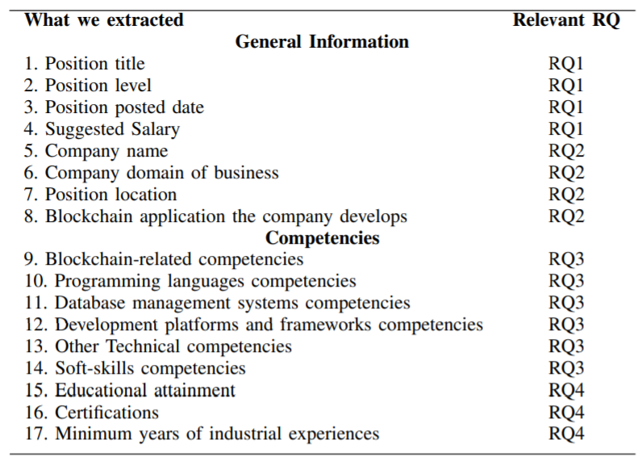
Extracting and Analyzing Data
A survey form was built using the “Qualtrics XM Platform” to store the extracted data.
The online form is available at the link http://bit.ly/35BiVd7.
To analyze the competencies, we executed a free-text analysis using “Text-iQ”.
For the quantitative assessment, we used “Stats iQ”.
The extracted data file is available online at the link https://bit.ly/3eucYDY
Notes:
Because the job posts detail the tasks and responsibilities, we applied qualitative coding techniques to the text descriptions related to competencies and tasks. Drawing upon Saldana’s qualitative data coding process [18], the analysis of each post granularly distinguished between tasks and competencies, and among the different types of competencies (blockchain-specific, technical, and soft-skills).
To analyze the competencies, we executed a free-text analysis that looks at the frequency of terms to determine the relevant data regarding specific job demands. For the freetext analysis, we used the “Text-iQ” feature provided by “Qualtrics”. For the quantitative assessment, we used “Stats iQ”, which is supplied with the “Qualtrics platform”. This feature performs a statistical analysis of the extracted data numerical parameters and resulted in the percentage of job posts that advertised each category of responsibilities and competencies. The extracted data file is available online at the link https://bit.ly/3eucYDY.

Slide 33
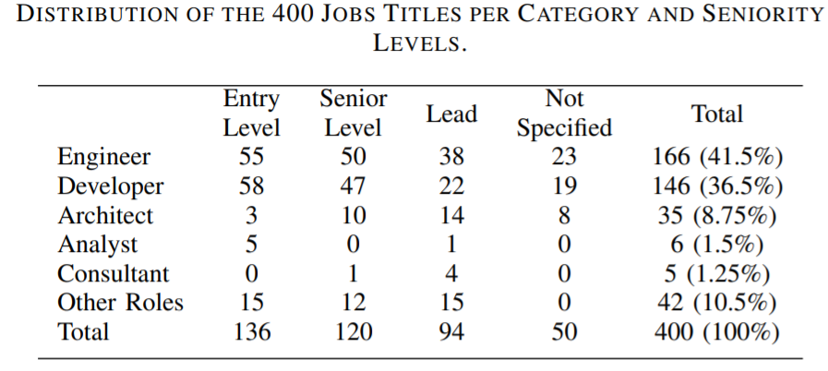
RQ1: Job Profiles for Blockchain Engineers
8% used programming languages names to define the position (e.g., Python developer).
25.8% of the advertised positions used the “blockchain” keyword in the title.
Only a small portion of the overall sample indicated whether it is for frontend development (4.1%), back-end development (3.6%), or a full-stack development (8.6%).
Notes:
1- At first glance, we can observe the diversity in position titles used to describe a blockchain development role. Around 41.5% of the posts were advertised as “engineer” positions, while 36.5% were advertised as “developer” positions, 8.8% as “architect” and 1.3% as “consultant”.
2- Additionally, some titles (8%) used particular programming languages names to define the position (e.g., Java developer, or Python developer).
3- Only in 25.8% of the advertised positions, the “blockchain” keyword was used in the title. The majority of the positions (53.5%) were advertised as senior or lead positions, which indicates the demand of level of experience for these positions (see table 2). In contrast, 34% were advertised as junior positions, and the remaining posts didn’t specify the seniority level of the role.
4-Only a small portion of the overall sample indicated whether it is for frontend development (4.1%), back-end development (3.6%), or a full-stack development (8.6%).

Slide 34
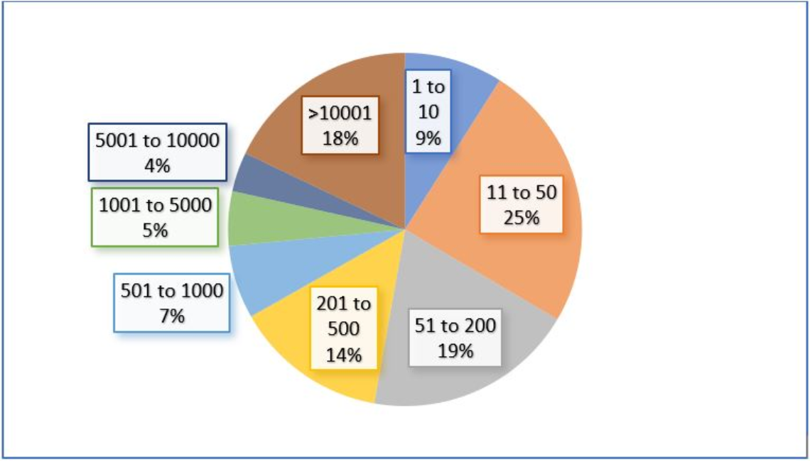
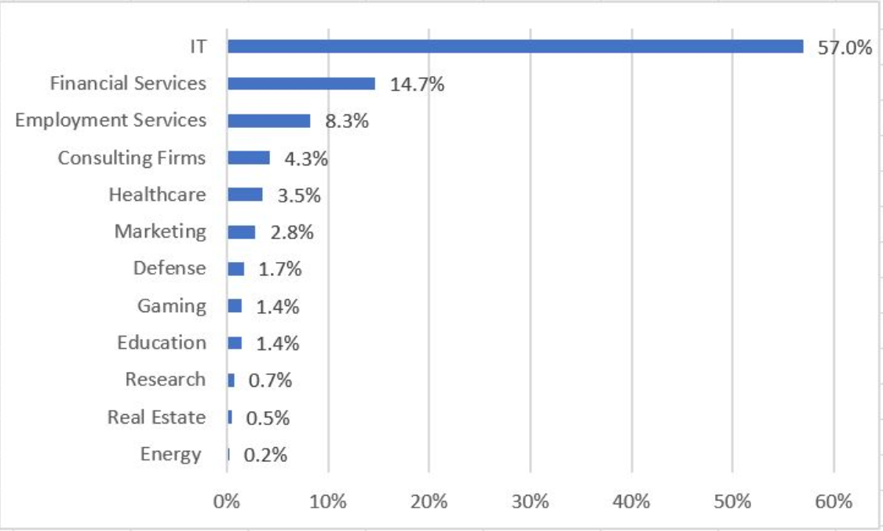
RQ2. Hiring Companies Profiles
Majority came from companies with the main business domain directly related to Information Technology (IT).
Apart from enterprises and established businesses, blockchain is of interest to small companies and startups.
Only 9.1% of the overall sample revealed the blockchain application that the company develops, and only for the 6.8% of the ads, the developed application was cryptocurrency related.
Notes:
1-Note that among the 400 job posts, the majority (56.9%) came from companies with the main business domain directly related to Information Technology (IT). Nevertheless, a wide range of business domains is still reflected in the extracted set (see Figure 1), such as finance, health, consultancy and logistics, and defence.
2-Apart from enterprises and established businesses, blockchain is of interest to small companies and startups. This is evidenced by the fact that more than half of the job ads from the analyzed sample belong to employers with small to medium sizes ( < 200 employees)
3-Only 9.1% of the overall sample revealed the blockchain application that the company develops, and only for the 6.8% of the ads, the developed application was cryptocurrency related.

Slide 35
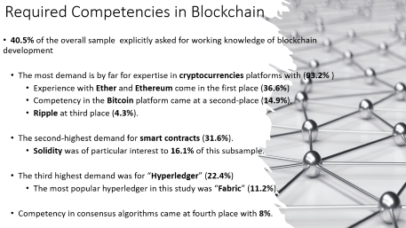
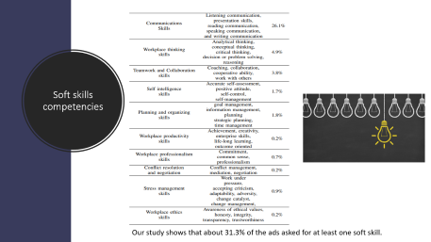
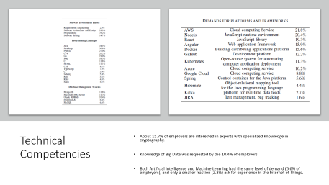
RQ3: Required competencies

Slide 36

Required Competencies in Blockchain
40.5% of the overall sample explicitly asked for working knowledge of blockchain development
The most demand is by far for expertise in cryptocurrencies platforms with (93.2% )
Experience with Ether and Ethereum come in the first place (36.6%)
Competency in the Bitcoin platform came at a second-place (14.9%),
Ripple at third place (4.3%).
The second-highest demand for smart contracts (31.6%).
Solidity was of particular interest to 16.1% of this subsample.
The third highest demand was for “Hyperledger” (22.4%)
The most popular hyperledger in this study was “Fabric” (11.2%).
Competency in consensus algorithms came at fourth place with 8%.
Notes:
1-There were 161 of the extracted ads (40.5% of the overall sample) that explicitly asked for working knowledge of blockchain development.
2-We further analyzed this particular subsample to explore the various blockchain-related competencies that are of interest to employers. The most demand is by far for expertise in cryptocurrencies platforms with 93.2% of ads from this subsample asking for familiarity with one or more cryptocurrencies platforms.
3-Experience with Ether and Ethereum come in the first place (36.6% of this subsample). Ethereum is a decentralized, open-source blockchain featuring smart contract functionality. Ether is the native cryptocurrency of the platform.
4-Competency in the Bitcoin platform came at a second-place (14.9%), and Ripple at third place (4.3%). The second-highest demand for blockchain-related competencies was for smart contracts (31.6%).
5-A smart contract that is stored on the blockchain can serve as a set of rules that oversee a business transaction and is executed automatically as part of a transaction. Solidity was of particular interest to 16.1% of this subsample. It is an object-oriented programming language for writing smart contracts. It is used for implementing smart contracts on various blockchain platforms, most notably, Ethereum.
6-The third highest demand was for “Hyperledger” (22.4%) which is an open-source community focused on developing a suite of frameworks, tools, and libraries for enterprise-grade blockchain deployments. The most popular hyperledger in this study was “Fabric” (11.2%). Competency in consensus algorithms came at fourth place with 8%.

Slide 37
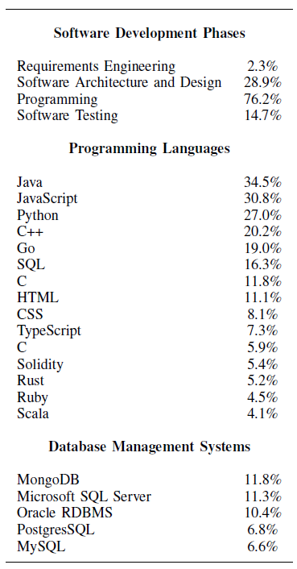
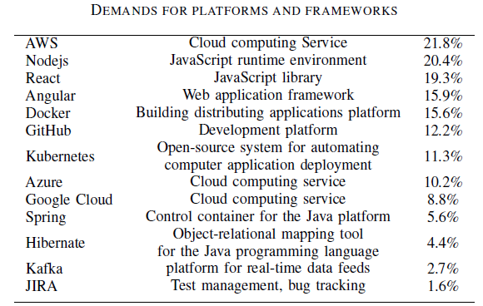
Technical Competencies
About 15.7% of employers are interested in experts with specialized knowledge in cryptography.
Knowledge of Big Data was requested by the 10.4% of employers.
Both Artificial Intelligence and Machine Learning had the same level of demand (6.6% of employers), and only a smaller fraction (2.8%) ask for experience in the Internet of Things.
Notes:
1-Besides blockchain competencies, the data indicates that employers are mostly interested in professionals with a grip on the entire development process.
2-About 28.9% of the overall employers ask blockchain experts to have working skills related to software design and architecture, and about 14.7% ask for testing skills. There was less demand for skills related to requirements engineering.
3-The majority of the employers (76.2%) require some programming skills, which implies a clear demand for professionals with programming and scripting capabilities.
4- Our results show that Java takes first place with 34.5% of the overall ads ask for it.
5-the second most demanded skill in development languages is JavaScript (30.8%). Third in line is having a Python competency with (27%), while C++ comes in fourth place (20.2%).
6- Table shows that most of the demand is for programming languages.
7-Thirty Percent of the ads ask for competency in one or more database management systems (Table 3). MongoDB took first
place (11.8%) and followed closely by Microsoft SQL Server (11.3%).
8-Moving our attention to software development tools and frameworks (Table 4), we note some demand for tools supporting
cloud computing, continuous integration, build management, and source control management.
9-These tools are not tailored solely for developers but are part of operating a continuous integration model [19], common in Agile and used across multiple roles.
10-The demand level is not high, though, and an explanation for it might be that these tools are easy to operate for standard usage; therefore, specific skills are unnecessary.
11-About 15.7% of employers are interested in experts with specialized knowledge in cryptography. We also looked at the
experience demand for other disruptive technologies.
12-Knowledge of Big Data was requested by the 10.4% of employers.
13-Both Artificial Intelligence and Machine Learning had the same level of demand (6.6% of employers), and only a smaller fraction (2.8%) ask for experience in the Internet of Things.

Slide 38
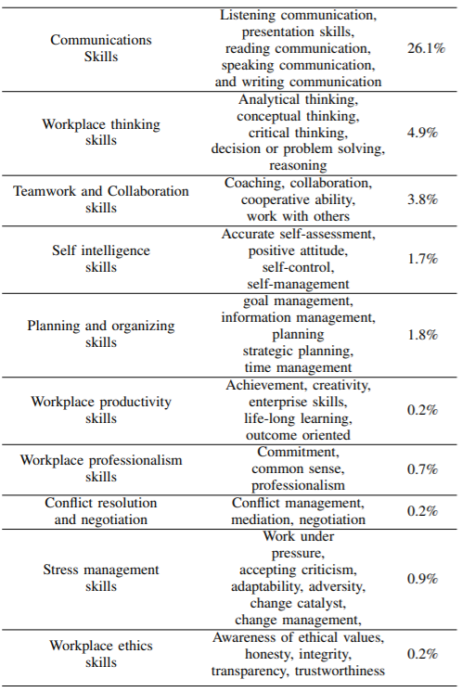

Soft skills competencies
Our study shows that about 31.3% of the ads asked for at least one soft skill.
Notes:
1-our analysis for soft skills in each ad, we executed textual analysis on the job description
(as described in Section 2), and then we mapped each advert to one or more soft skills defined in the Soft Skills Taxonomy
[20] (see table 5).
2-Our study shows that about 31.3% of the ads asked for at least one soft skill.
3-Communication skills comprising presentation skills, reading communication, speaking communication, and writing
communication are among the most demanded by employers
4-Workplace thinking skills (e.g., Analytical thinking, conceptual thinking, critical thinking, decision making, decisiveness, problem-solving, reasoning) come in second place with 4.9% of the ads are asking for at least one skill in this category.

Slide 39

RQ4. Education & Experience
The highest number of job posts (48.8%) ask for completed bachelor degrees as a minimum educational requirement.
Only (3.5%) ask for the completion of a master’s degree or a Ph.D.
47.7% does not specify any degree requirements.
One in ten hiring employers asks for particular certifications.
25% of these mentioned AWS (e.g., AWS Solutions, AWS Architect Associate, AWS Cloud Practitioner, AWS Developer Associate).
15% referred to any blockchain certification as a requirement.
12.5% of this subsample asks for Oracle certificate.
73.8% of the overall posts listed a minimum of years of experience.
The average number for the minimum years of experience from all posts is 4.8 years.
Notes:
1-The highest number of job posts (48.8%) ask for completed bachelor degrees as a minimum educational requirement.
2-Only (3.5%) ask for the completion of a master’s degree or a Ph.D. While the 47.7% does not specify any degree requirements. Certifications are a common way to complement a degree. However, the industrial demand for certifications is low when compared to a classic undergraduate or graduate degree.
3- One in ten hiring employers asks for particular certifications. When we scanned these ads thoroughly, we observed that 25% of these mentioned AWS certification making it the most popular (e.g., AWS Solutions, AWS Architect Associate, AWS Cloud Practitioner, AWS Developer Associate). Only about 15% of the ads requiring any certification referred to any blockchain certification as a requirement. Conversely, despite the low demand for blockchain certificates, it would be expected that demand will increase in this area as the demand for blockchain engineers keeps on increasing. Blockchain training programs have been increasing recently and are now being offered by some of the nation’s leading universities, including MIT, Princeton, and Stanford. Many blockchain vendors such as Consensys, Blockapps, the Ethereum Foundation, and Hyperledger also provide training programs and certificates. The demand for an Oracle certification came in third place at 12.5% of this subsample.
4-73.8% of the overall posts listed a minimum of years of experience as a requirement, making it one of the most demanded requirements among all. The average number for the minimum years of experience from all posts is 4.8 years.

Slide 40

Insights
There is a high demand for blockchain professionals with competency in the whole development process, including software design and architecture. Programming skills are fundamental
Despite being one of the most obvious responsibilities of a blockchain engineer job, fewer job postings explicitly include required experience in blockchain development itself than experiences in programming in general.
The technical experience is valued more than domain specific knowledge.
only 7.5% of the posts require domain knowledge in finance or fintech.
Notes:
There is a high demand for blockchain professionals with competency in the whole development process, including software design and architecture. Programming skills are fundamental
Despite being one of the most obvious responsibilities of a blockchain engineer job, fewer job postings explicitly include required experience in blockchain development itself than experiences in programming in general. This is probably because, being the field still new, companies are trying to hire traditional software engineers and then convert them into blockchain engineers along the way.
- The technical experience is valued more than domainspecific knowledge. For example, even though the blockchain is the essence of the infrastructure underlying cryptocurrencies, only 7.5% of the posts require domain knowledge in finance or fintech. This is probably because the technological aspects, at this stage, are still predominant and there is a need for building infrastructure which will then require a finance background.

Slide 41
Insights
Previous experience plays an essential role during the hiring process for a blockchain engineer role and more than the academic degrees and certificates.
Even with low demand for formal education or certification in blockchain from the current job market, this demand is likely to increase soon
Even though a small fraction of the overall posts revealed the blockchain platform that the company develops, we can translate the high demand for competency in cryptocurrency platforms into the assumption that cryptocurrency development still dominates the landscape of blockchain engineering.
Notes:
Previous experience plays an essential role during the hiring process for a blockchain engineer role and more than the academic degrees and certificates. This is probably due to the (not new) slow-response of the academic world to the market needs. The lack of dedicated educational paths in the blockchain field and the difficulties in shaping a new area of study given the speed these new technologies are growing force the companies interested in these new professional figures to bend towards preferring experience instead of a not specific educational background.
5) Even with low demand for formal education or certification in blockchain from the current job market, this demand is likely to increase soon. Research into the educational implications of blockchain is moving rapidly, and several universities have started to offer courses about blockchain [23]. However, it is crucial for academia to intercept the markets’ needs and quickly fill the currently existing gaps.
6) Even though a small fraction of the overall posts revealed the blockchain platform that the company develops, we can translate the high demand for competency in cryptocurrency platforms into the assumption that cryptocurrency development still dominates the landscape of blockchain engineering.

Slide 42
Software Engineering and IoT

Slide 43
INTRODUCTION OF iot
Definition of the Internet of Things (IoT).
Kevin Ashton's 1999 definition emphasizing uniquely identifiable objects/things connected through the Internet Protocol.

Slide 44

GROWTH OF IOT
Statistics on the growth of IoT devices: 8.4 billion connected things in 2017 (excluding laptops, computers, tablets, and mobile phones).
Expected growth to 25.1 billion IoT devices by 2025 (according to the GSM Association).

Slide 45
Challenges in Building IoT Requirements
The newness of the domain and the need for domain knowledge.
Focus on fitness of purpose, wireless interoperability, and energy efficiency.
Challenges in eliciting quality requirements, especially in domains like healthcare and education.

Slide 46

Security Concerns in IoT
Increased security-related concerns due to IoT complexity.
Questions about data ownership and privacy.
The need for legal entities and government oversight in addressing these concerns.

Slide 47

Scalability Requirements
Importance of addressing scalability requirements due to the high volume of sensor data.
Unique data access patterns in IoT compared to traditional business data.

Slide 48
EMERGENCE OF NEW QUALITY ATTRIBUTES
Discussion on the emergence of new quality attributes in IoT.
Concerns about the impact of IoT on human lives, personal control, and autonomy.
Examples of the impact on education and healthcare.

Slide 49
Example: IoT in Education
IoT applications are being proposed to address a diverse range of modes, objectives, subjects and perceptions in education sector.
Monitoring attendance and in-class activities.
Monitoring students and objects in online class / labs.
IoT is also being deployed for more pragmatic scenarios in education.
Increasing children’s knowledge about agricultural food production and consumption .
Educating students with special needs exist (e.g. for children with Autism Spectrum Disorder) .
Notes:
IoT applications are already being leveraged in diverse domains such as medical services field, smart retail, customer service, smart homes,
environmental monitoring, and industrial internet. Now, because of their ubiquitous nature, schools and academic institutions are looking
to incorporate IoT in educational activities to benefit students, instructors, and the entire educational system. IoT

Slide 50
What are the Challenges of Incorporating IoT in Education?
SECURITY
SCALABILITY
HUMANIZATION

Slide 51
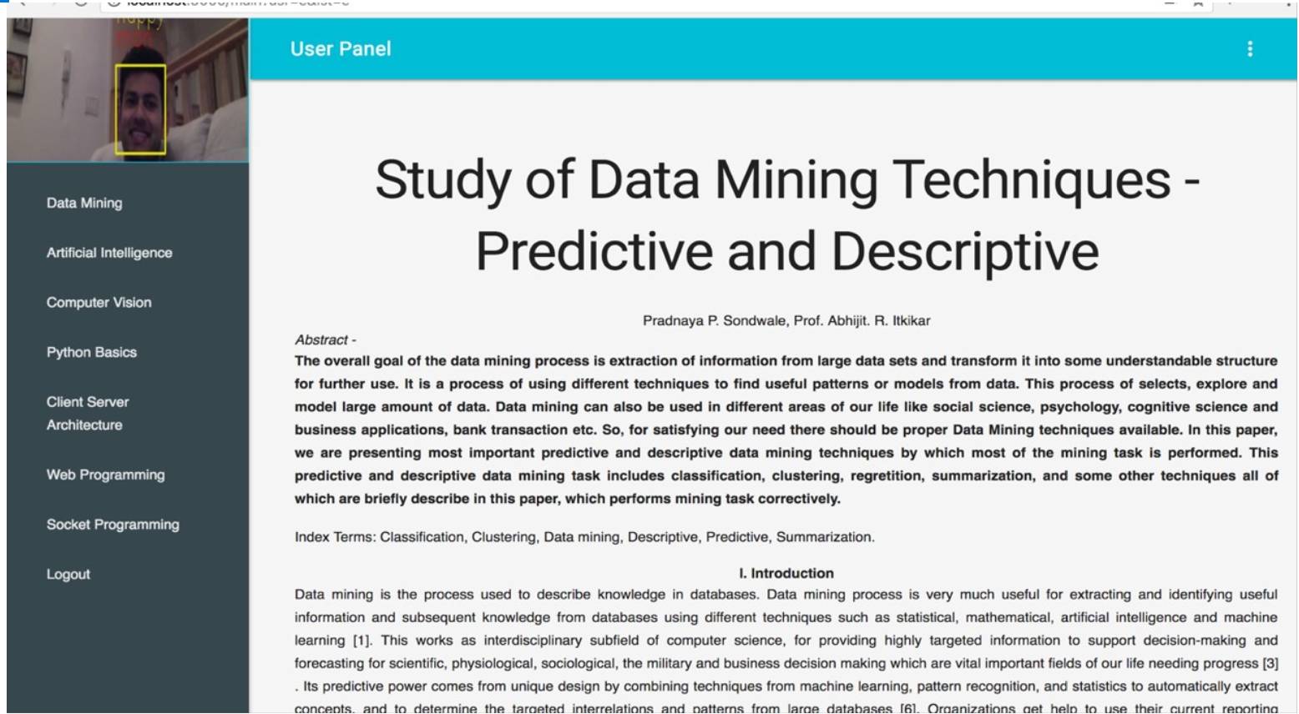
Notes:
With this background in mind, we developed a Learning Management System (LMS) that supports capturing and reacting to remote learner’s emotions in real time. The LMS was developed using Python 3.7. The system uses for client APIs: JQuery , material for page UI and Websocket for communicating with web server. The system utilizes for Server APIs: Tornado framework for web service, OpenCV, Keras CNN model, and TensorFlow API for real-time face detection and emotion/gender classification. The integrated system captures user’s expressions based on the gender against the on-line content and time stamp. It detects seven emotion expressions: angry, disgust, fear, happy, sad, surprise, neutral.
Once a learner logs into the website, the system triggers a pop up message notifying that the web cam will be turned on. After acknowledging the message and while navigating through the on-line materials (Figure 2), the system captures facial expressions of a learner. The tool captures user’s web cam frame data with websocket addressed once in every 100ms.

Slide 52
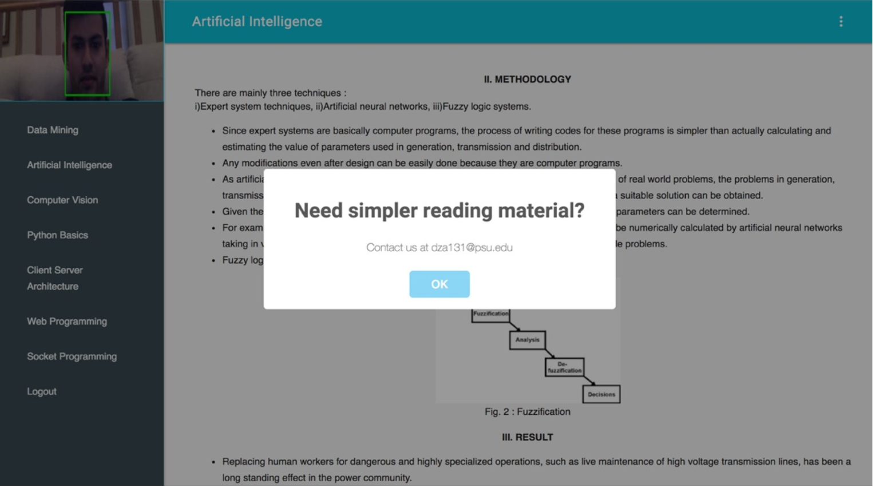
Notes:
The system evaluates the expressions once every 10 seconds as per customized parameters which can be modified by a course administrator. The system detects whether user’s expressions match with the customized parameters while navigating particular content (e.g. a percentage of emotional expressions (sad, happy, etc.) within any 10 seconds time frame). If there is a match then the system prompts a learner with the option of supplemental learning materials customized according to learner’s state and the particular content (Figure 3).
In addition, an “aggregator” component sends periodically an aggregated data on the learner’s profile and the entire on-line class state to the course instructor. The captured data can serve for the wellbeing of the individual student and for the entire class. While the initial phase of project successfully integrated a facial emotional expressions API, we are currently working on the next phase of the tool to integrate eye-gaze tracking and heart beats monitoring APIs. These two additional types of detentions will allow us to position more precisely the state of a remote learner simultaneously while reading the course content, participating in the on-line designated discussions forums or writing the course assignments.

Slide 53
Types of IoT Testing
Functional Testing: Verify if the devices and systems perform as intended. Test device interactions, data flows, and responsiveness.
Compatibility Testing: Ensure compatibility across various devices, operating systems, and communication protocols.
Performance Testing: Assess the scalability, responsiveness, and resource consumption of IoT systems under different loads.
Security Testing: Identify vulnerabilities, protect data integrity, and prevent unauthorized access.
Reliability Testing: Test the system's ability to function consistently under varying conditions and over extended periods.
Interoperability Testing: Evaluate how well devices from different manufacturers communicate and work together.
Usability Testing: Ensure that the user interface and overall user experience meet user expectations.
OTA (Over-the-Air) Testing: Validate the ability to remotely update device firmware and software.
Edge Case Testing: Test extreme and unexpected scenarios to uncover potential issues.

Slide 54
Considerations when testing for IoT devices
Device Diversity: Test across various devices, sensors, and platforms to cover a wide range of scenarios.
Intermittent Connectivity: Test for scenarios with unstable or intermittent network connections.
Security Concerns: Address potential security vulnerabilities and data privacy issues.
Firmware Updates: Test the process of remotely updating the firmware without disrupting device functionality.
Real-Time Constraints: Account for time-sensitive interactions and responses in testing scenarios.

Slide 55
Recent Publications on IoT in Education
DeFranco, J., Kassab, M. (2021). What every engineer should know about the internet of things? CRC Press Taylor & Francis Group
Kassab, M., DeFranco, J., & Laplante, P. (2020). A systematic literature review on internet of things in education: Benefits and challenges. Journal of Computer Assisted Learning, 36(2), 115-127.
Kassab, M., & Mazzara, M. (2019). Towards Designing Smart Learning Environments with IoT. In DEVOPS 2019 - Second international workshop on software engineering aspects of continuous development and new paradigms of software production and deployment.
DeFranco, J., & Kassab, M. (2019). Considerations for an internet of things curriculum. In 2019 Hawaii International Conference on System Sciences (HICSS-52). Maui. HI.
Kassab, M., Graciano Neto, V. V., & Allian, A. (2019). Investigating quality requirements from a human perspective in IoT-based software architectures for education. In International Workshop on Software Architectures and Human Values in conjunction with the 13th European Conference on Software Architecture (ECSA). ISBN 978-1-4503-7142-1. Paris. France.
Kassab, M., DeFranco, J., & Voas, J. (2018). Smarter education. IT Professional, 20(5), 20–24.
DeFranco, J., Kassab, M., & Voas, J. (2018). How do you create an internet of things workforce? IT Professional, 20(4), 8–12.
Laplante, P., Kassab, M., Laplante, N. L., & Voas, J. (2017). Building caring healthcare systems in the internet of things. IEEE systems journal, 12(3), 3030–3037.

Slide 56

Related Book

Slide 57

AI AND SOFTWARE ENGINEERING (Open Discussion)

Slide 58

Readings , Assignments, Project Tasks
Read:
Chapter 29

